Slide 1

Unusual ways of getting around
Svetlichanaya Alina

Slide 2
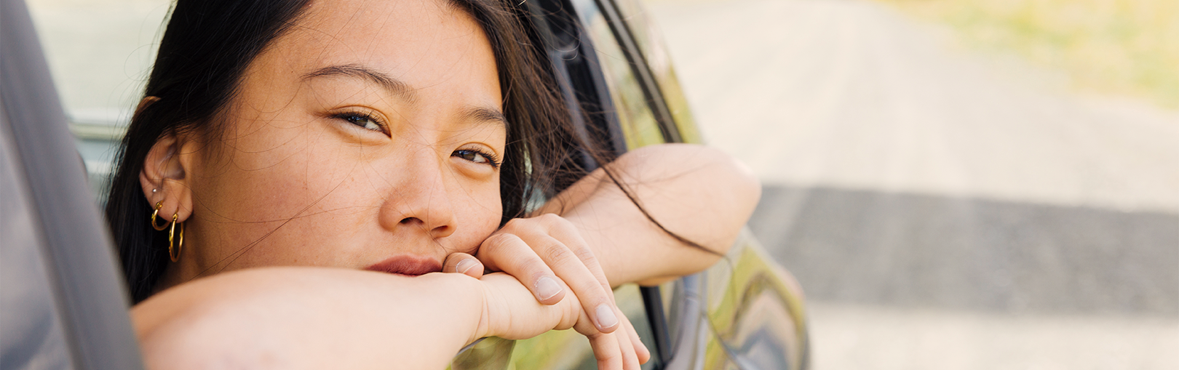
“Of all the creations of human hands, the car most resembles a living creature.”
— Sir William Lyons

Slide 3
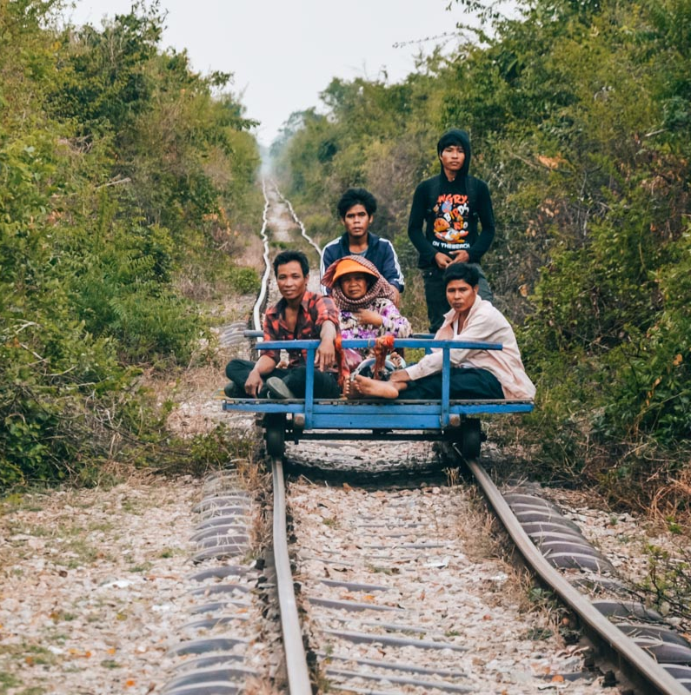
Bamboo trains

Slide 4
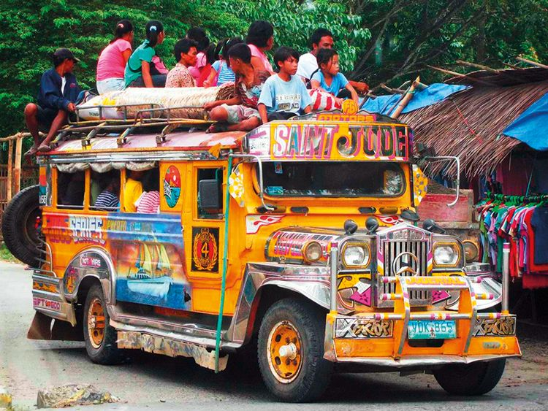
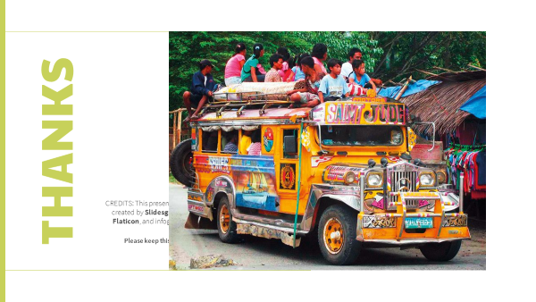
Jeepney

Slide 5
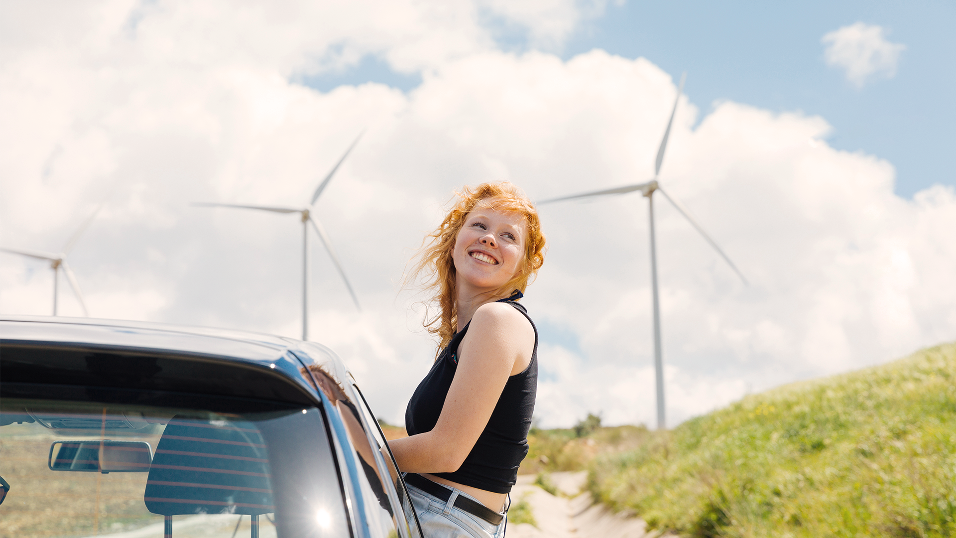
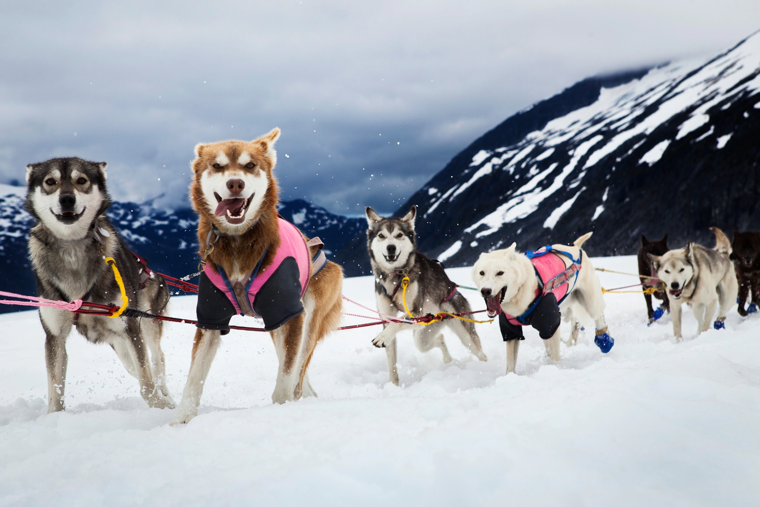
Dog sleds

Slide 6
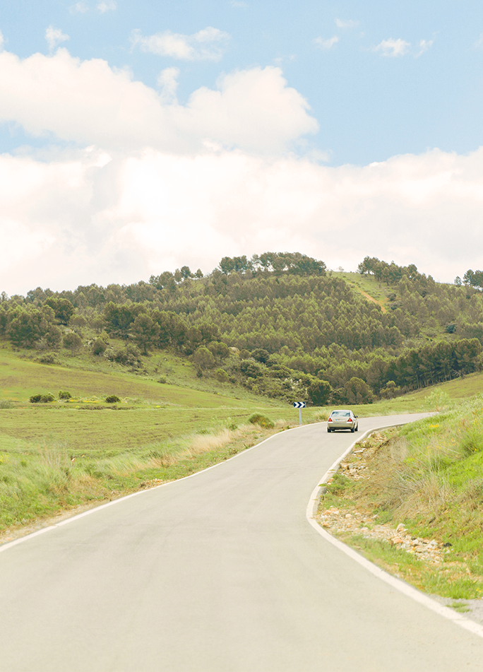
For attention
T
H
For attention
A
N
K
S

